Slide 1
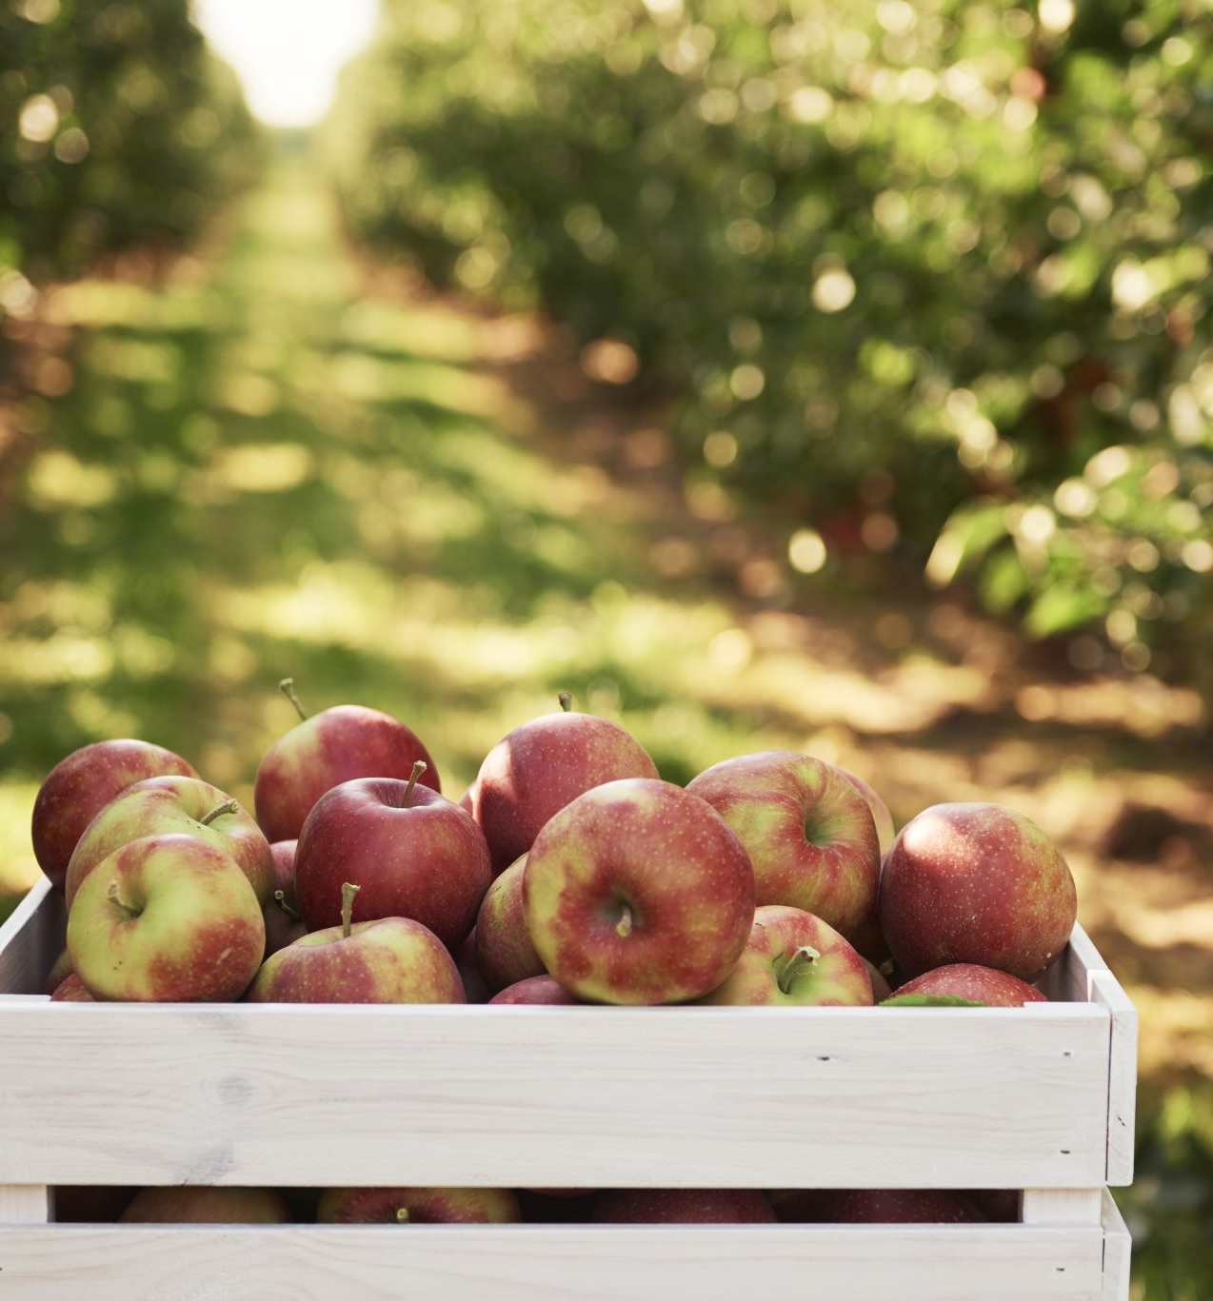
Smart Apple Picking Prediction using IOT
By Team 4
1. Surya Anirudh Lanka
2. Dhanunjaya Koneru
3. Sai Harish Chitluri
4. Nagaraju Rathna
5. Pushpa Uppala
6. Badiri Nadh Mamidi
7. Gopi Rao Kotapothula

Slide 2
In traditional apple picking methods, challenges arise, leading to inefficiencies and inaccuracies. The need for a more efficient and accurate apple picking process is crucial for optimizing harvests. Our solution leverages Machine Learning (ML) and the Internet of Things (IoT) to create a modern and efficient apple picking system.
Motivation

Slide 3

Current Problems
Manual Labor Intensity:
Traditional apple picking methods are often labor-intensive, requiring significant manual effort.
The reliance on human labor can lead to inefficiencies and increased operational costs.
Inaccuracies in Selection:
Human error in selecting ripe apples for harvesting may lead to the picking of unripe or overripe fruits.
Inaccuracies impact the overall quality of the harvest and can result in financial losses.
Time-Consuming Process:
The conventional method of visually inspecting each apple is time-consuming, especially in large orchards.
Time delays can affect the freshness of the harvested fruits and decrease overall productivity.
Seasonal Labor Dependency:
The dependence on seasonal labor for apple picking can create challenges in terms of workforce availability and training.
Seasonal labor shortages can further exacerbate the problem, especially during peak harvesting times.

Slide 4

Our Solution
Overview of the system: We combine ML and IoT to revolutionize the apple picking process.
Vision transformers: Vision transformers were chosen for their effectiveness in image recognition tasks.
Finetuning process: The model is finetuned using a dataset of 4000 labeled images for optimal performance.
Mobile app integration: Users can employ a mobile app for real-time apple scanning with instant feedback.

Slide 5
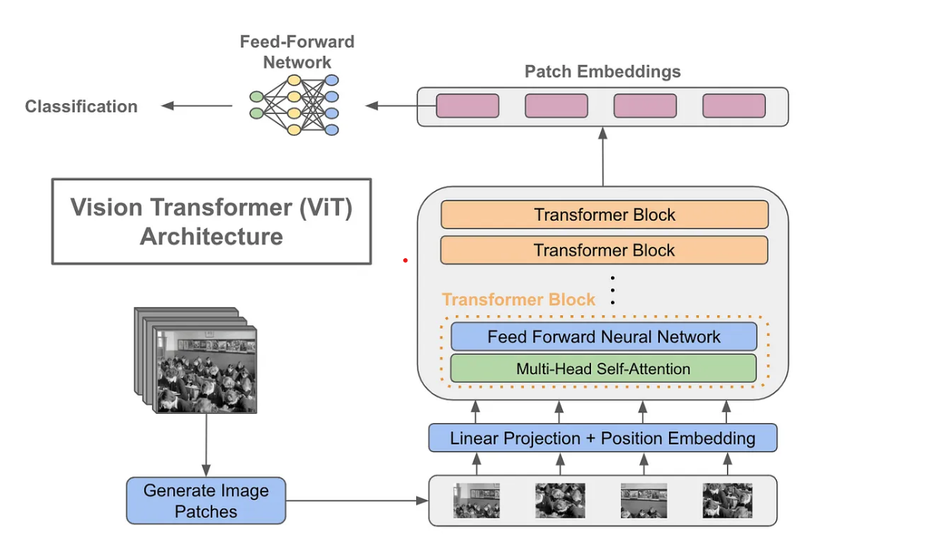
Vision Transformers
Vision Transformers (ViTs) represent a breakthrough in computer vision, challenging traditional Convolutional Neural Networks (CNNs) for image classification tasks..
ViTs adapt the transformer architecture to process images as sequences of patches rather than grids of pixels.
Images are divided into smaller patches, treating each patch as a sequence of values.
ViTs excel at capturing long-range dependencies in images, making them well-suited for tasks like image classification and object detection.

Slide 6

Apple Type Recognition
We gathered a dataset comprising images of 2 different apple types, pink lady and red delicious.
Automated solutions are essential for efficiently handling the extensive variety of apples.
We employ machine learning techniques, including deep neural networks, to recognize and classify apple types based on visual features.
The combination of apple type recognition and picking prediction enhances the precision and efficiency of the harvesting process.
The flexibility of the model allows for easy expansion to recognize additional apple varieties.

Slide 7

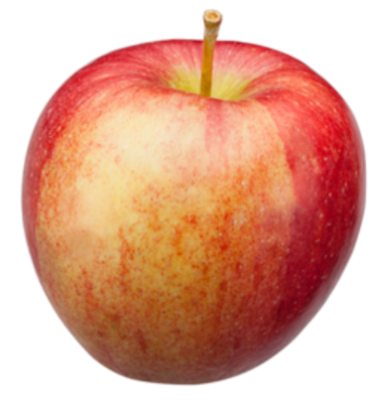
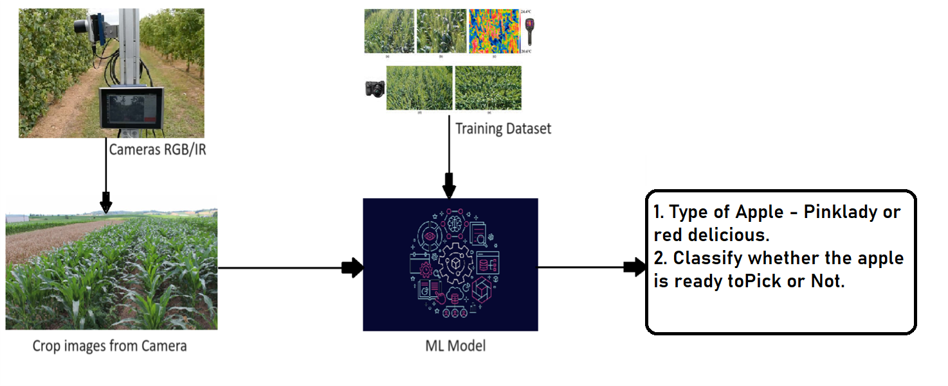
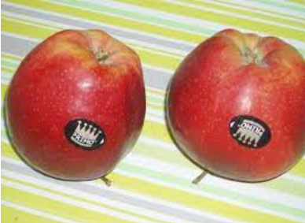
Workflow

Slide 8
Results & Performance
Accuracy: The model demonstrates high accuracy of 93% during testing, ensuring reliable predictions.
Real-world testing: Field testing and validation results contribute to the real-world applicability of the solution.
Efficiency gains: The solution significantly improves efficiency compared to traditional apple picking methods.

Slide 9
Future Scope
Integrate ML Model with Mobile Application to show insights in a Dashboard
Exploring of Possibilities of expanding the application model to wide variety of apples
Automating the apple picking with the help of Andro Humanoid robot by visiting apple harvests.
Plans for scaling up the solution to work for larger fields.

Slide 10

The end

